Slide 1
Women in Business
By Noelle Brooks, Lani Jones, and Jennifer Nolos
Entity Virtual Academy/ Woz U

Slide 2

Who We Are: Lani Jones
Public Relations, Bachelor’s Degree, University of Central Oklahoma
Data Science, Entity Virtual Academy/ Woz U
Graphic Designer and Publishing Assistant
Goal: Live in London, England

Slide 3

Who We Are: Jennifer Nolos
Chemical Engineering, Bachelor’s Degree, Syracuse University
Data Science, Entity Virtual Academy/ Woz U
Associate Banker for JP Morgan Chase
Goal: land an entry-level data analyst position with JPMC

Slide 4

Who We Are: Noelle Brooks
Mass Communication – Print Concentration, Bachelor’s Degree, Georgia College & State University
Executive MBA, Masters Degree, Wesleyan College
Data Science, Entity Virtual Academy/Woz U
Marketing Coordinator for Choice Premiums
Goal: Get an entry level data analyst job with a start-up or hire myself as co-founder of a tech start-up

Slide 5
About the Project
Our Data Is From
US Census Bureau
Women’s Business Enterprise National Council (WBENC)
Project Background
As women professionals, we want to understand what success for women looks like in the marketplaces.
One want to analyze this is through the lens of women entrepreneurs

Slide 6
Initial Goals For The Project
Analyze remote work in women owned businesses
Connection between remote work and revenue
Connection between remote work and employee satisfaction
Top industries of women owned remote/partially remote businesses
Comparison between remote/partially remote businesses vs. non-remote

Slide 7


Slide 8
Goals For The Project
Sales growth for women owned businesses vs men owned businesses
Factors that contribute to successful women owned businesses
Employee growth rate for women owned businesses
Top industries for women entrepreneurs
Connection between race, ethnicity, and gender as it relates to businesses

Slide 9
Methods & Tools Used
Researched datasets with large samples and multiple variables
Explored reliable databases for historical data
Reviewed directories for real time data
Wrangled & assessed data with Python, R, & Tableau
Analyses focused on finding relationships between variables
Statistical formulas to assess
Trello for project management

Slide 10
Analysis

Slide 11
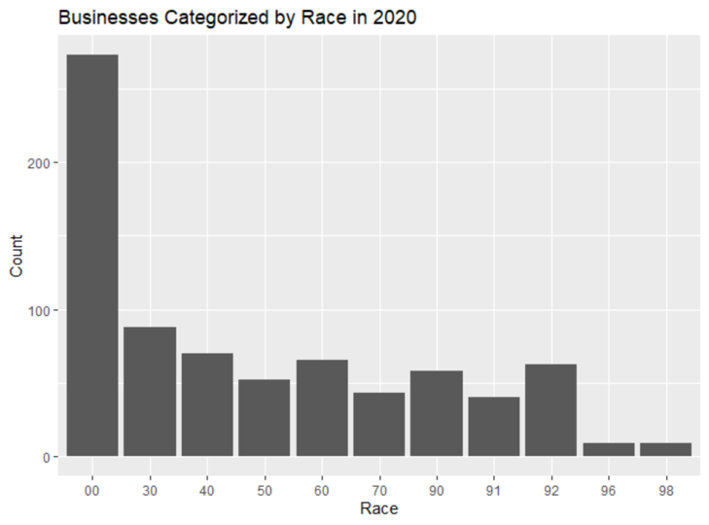
Must ignore the first value “00” since it accounts for the total of all races.
Majority of businesses owners were white, Caucasian
Second dominating race were black, African-American owners

Slide 12
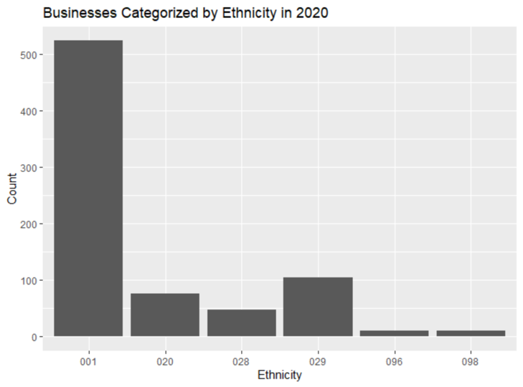
Must ignore the first value “001” since it accounts for the total of all ethnicities.
Majority of businesses owners’ ethnicity were non-Hispanic
While in second, were business owners that were Hispanic

Slide 13
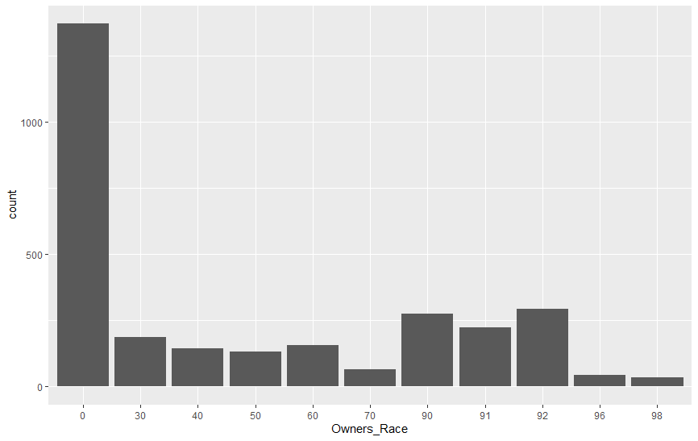
Businesses Categorized by Race 2019
Must ignore the first value “0” since it accounts for the total of all races.
Majority of businesses owners were white, Caucasian
Second dominating race were black, African-American

Slide 14
Businesses Categorized By Ethnicity 2019
Must ignore the first value “0” since it accounts for the total of all ethnicities.
Majority of businesses owners’ ethnicity were non-Hispanic
While in second, were business owners that were Hispanic

Slide 15
Businesses Categorized by Race 2018
Must ignore the first value “0” since it accounts for the total of all races.
Majority of businesses owners were white, Caucasian
Second dominating race were black, African-American

Slide 16
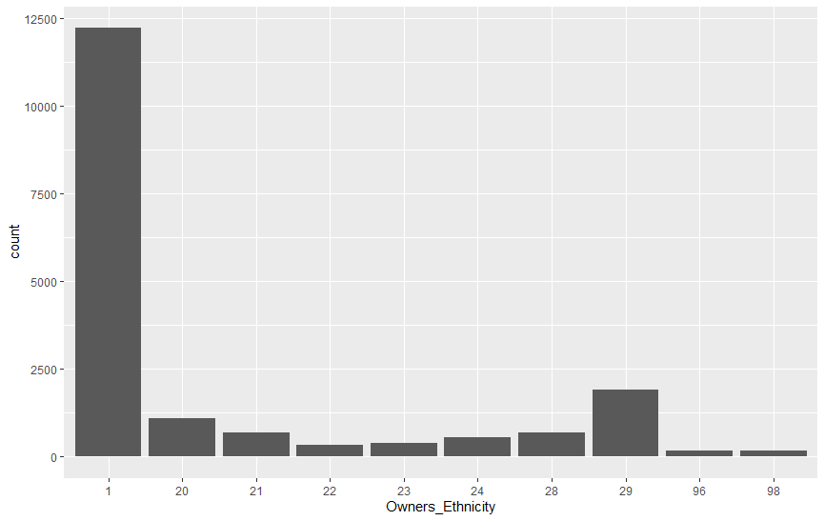
Businesses Categorized By Ethnicities 2018
Must ignore the first value “1” since it accounts for the total of all ethnicities.
Majority of businesses owners’ ethnicity were non-Hispanic
While in second, were business owners that were Hispanic

Slide 17
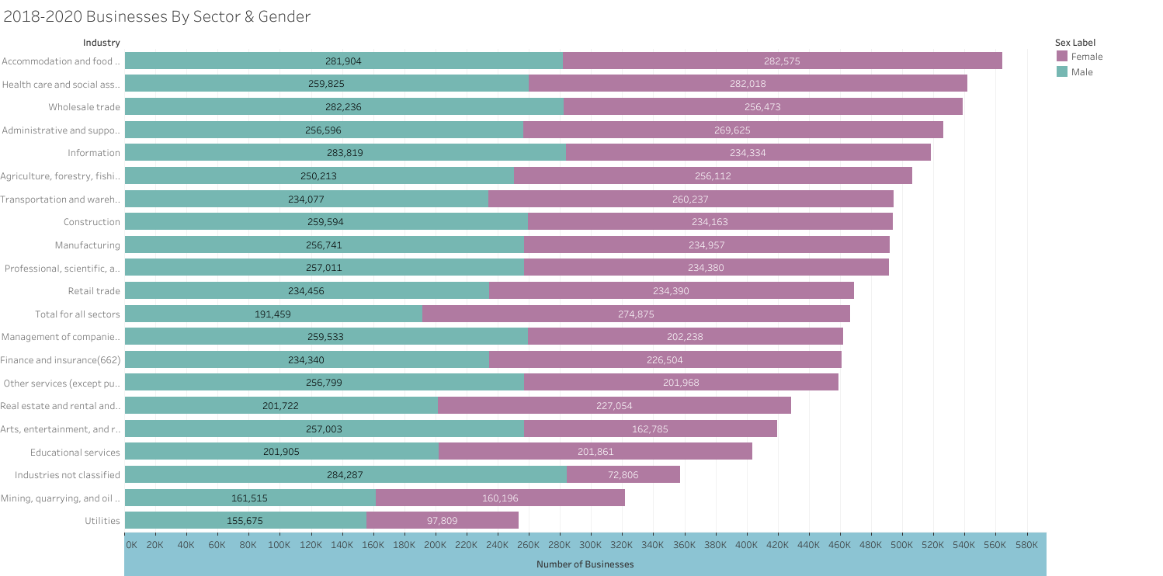

Slide 18
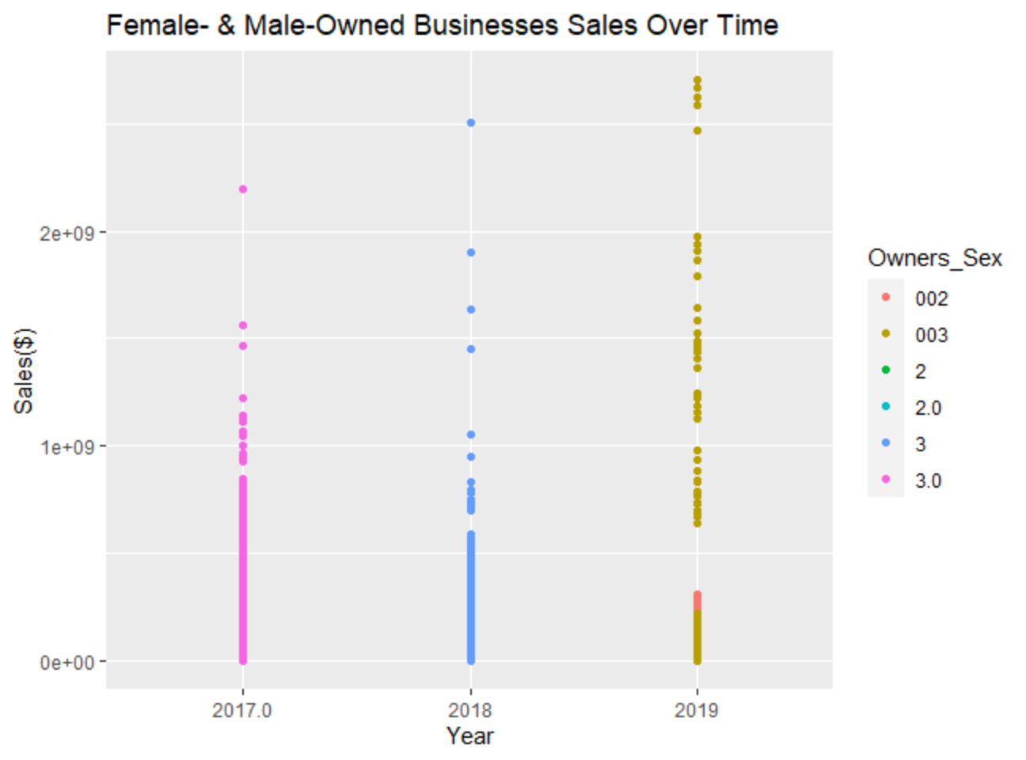
Datapoints are concentrated between each year
Shows a slight positive, upward trend
Growth rate for male owned businesses: 14.8%
Growth rate for female owned businesses: 13.08%

Slide 19
Results Summary
The results section will be the meat of your presentation. You should divide your results section into parts by evaluation question, so that you can easily signpost things. In the results section, you will go over any of the exploratory findings you have you want discuss, as well as the answers to each evaluation question. Ensure that you provide LOTS of beautiful visuals to go along with your findings.
Top 5 industry sectors in 2020:
1. Professional, Scientific, and Technical Services
2. Health Care and Social Assistance
3. Accommodations and Food Services
4. Manufacturing
5. Transportation and Warehousing
Top 5 industry sectors in 2019:
1. Professional, scientific, and Technical Services
2. Health Care & Social Assistance
3. Administrative and support and Waste Management and Remediation Services
4. Wholesale Trade
5. Accommodations & Food Services

Slide 20
Results Summary Con’t.
Top 5 Industry Sectors in 2018:
1. Administrative and support and Waste Management and Remediation Services
2. Health Care and Social Assistance
3. Professional/Scientific/Technical Services
4. Accommodation and Food Services
5. Construction
Top 3 Industry Sectors Over Past Three Years
1. Health Care And Social Assistance
2. Professional, Scientific, and Technical Services
3. Administrative and Support and Waste Management and Remediation Services

Slide 21
Lessons Learned

Slide 22
Questions

